Slide 1
Linear Programming
Dr. MD Sarder
Notes:
Today we will solve LP problem by Simplex Method. An assignment is already posted in the WebCT! Read uploaded materials on Simplex method in the WebCT.

Slide 2
Simplex Method
When decision variables are more than 2, it is always advisable to use Simplex Method to avoid lengthy graphical procedure.
The simplex method is not used to examine all the feasible solutions.
It deals only with a small and unique set of feasible solutions, the set of vertex points (i.e., extreme points) of the convex feasible space that contains the optimal solution.
Notes:
In the graphical method we mentioned that if decision variables are more than 2 it is very hard to solve. In this case we will use Simplex Method which does not explore all feasible solutions. It explores only some extreme points and find the optimum solution.

Slide 3
Simplex Method
General Steps involved:
  Locate an extreme point of the feasible region.
  Examine each boundary edge intersecting at this point to see whether movement along any edge increases the value of the objective function.
  If the value of the objective function increases along any edge, move along this edge to the adjacent extreme point. If several edges indicate improvement, the edge providing the greatest rate of increase is selected.
  Repeat steps 2 and 3 until movement along any edge no longer increases the value of the objective function.
Notes:
These are generic steps of Simplex method – we will use these steps to solve a sample LP problem.

Slide 4
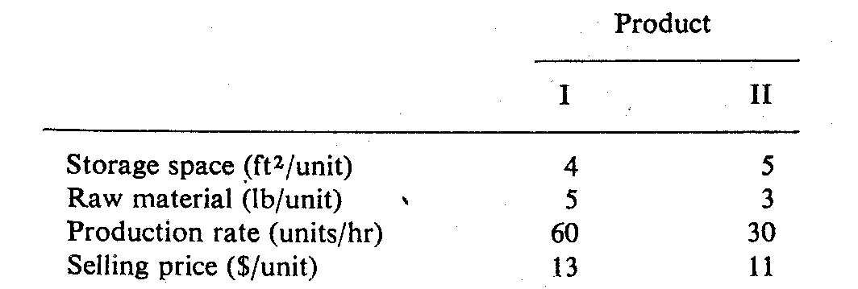
Simplex Method
Example: Product Mix Problem
The N. Dustrious Company produces two products: I and II. The raw material requirements, space needed for storage, production rates, and selling prices for these products are given below:
The total amount of raw material available per day for both products is 15751b. The total storage space for all products is 1500 ft², and a maximum of 7 hours per day can be used for production. The company wants to determine how many units of each product to produce per day to maximize its total income.
Notes:
This slide describes a sample Product Mix Problem. Unit requirements of resources for each product and availability of resources are given. The company wants to determine how many units of each product to produce per day to maximize its total income.

Slide 5
Simplex Method
To solve a standard maximization problem using the simplex method, we take the following steps:
Step 1. Convert to a system of equations by introducing slack variables to turn the constraints into equations, and rewriting the objective function in standard form.
Step 2. Write down the initial tableau.
Step 3. Select the pivot column: Choose the negative number with the largest magnitude in the objective row. Its column is the pivot column. (If there are two candidates, choose either one.) If all the numbers in the objective row are zero or positive, then you are done: the basic solution maximizes the objective function.
Notes:
These are specific steps of Simplex method – we will use these steps to solve a sample LP problem.

Slide 6
Simplex Method
Step 4. Select the pivot in the pivot column: The pivot must always be a positive number. For each positive entry b in the pivot column, compute the ratio a/b, where a is the number in the Answer column in that row. Of these test ratios, choose the smallest one. The corresponding number b is the pivot.
Step 5. Use the pivot to clear the column in the normal manner (taking care to follow the exact prescription for formulating the row operations described in Chapter 2) and then re-label the pivot row with the label from the pivot column. The variable originally labeling the pivot row is the departing or exiting variable and the variable labeling the column is the entering variable.
Step 6. Go to Step 3.
Notes:
These are specific steps of Simplex method – we will use these steps to solve a sample LP problem.

Slide 7
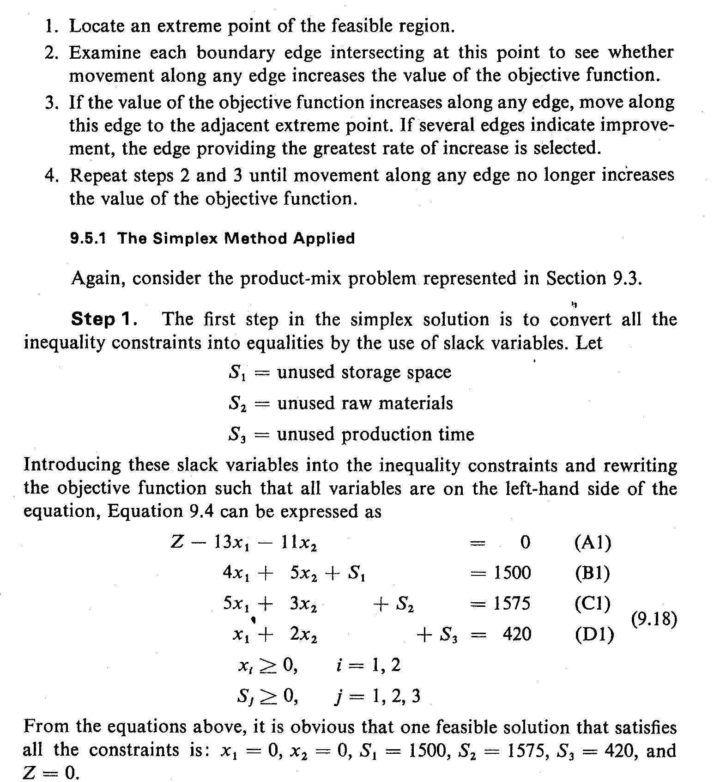
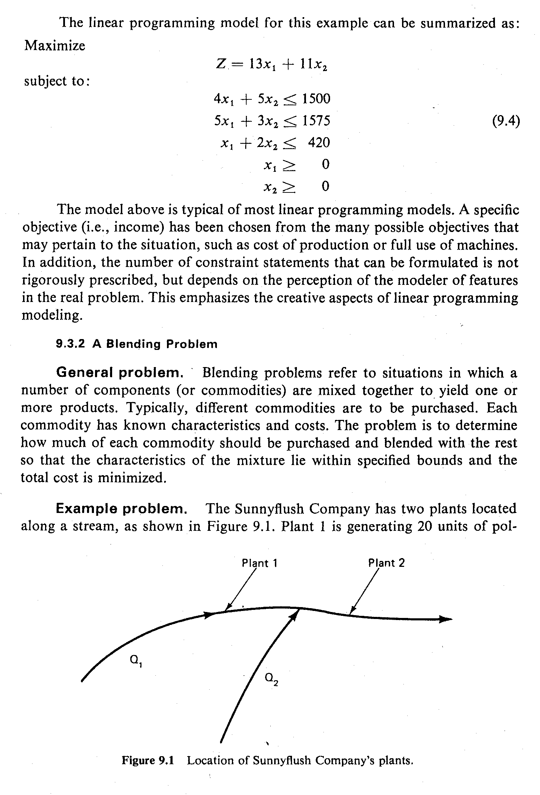
The Simplex Method (1)
Solution
Convert all the inequality constraints into equalities by the use of slack variables.
Let:
As already developed, the LP model is:
  …..Eq (1)
Notes:
First, write objective function and constraints equations as follows.
Convert all the inequality constraints into equalities by the use of slack variables.

Slide 8
The Simplex Method (2)
Introducing these slack variables into the inequality constraints and rewriting the objective function such that all variables are on the left-hand side of the equation. Equation 1 can be expressed as:
  …..Eq (2)
Notes:
Equation 2 shows all converted equations.

Slide 9
Simplex Tableau for Maximization (1)
Step I: Set up the initial tableau using Eq. (2).
  …..Eq (2)
In any iteration, a variable that has a nonzero value in the solution is called a basic variable.
Basic variable | Z | x₁ | x₂ | s₁ | s₂ | s₃ | r.h.s. | Ratio
Z | 1 | -13 | -11 | 0 | 0 | 0 | 0
s₁ | 0 | 4 | 5 | 1 | 0 | 0 | 1500
s₂ | 0 | 5 | 3 | 0 | 1 | 0 | 1575
s₃ | 0 | 1 | 2 | 0 | 0 | 1 | 420
Notes:
Create a table as follows and populate the table with the coefficients of equation 2. The first row of this table represents coefficients of equation A1. In the first row you can see that the coefficients of S1, S2, and S3 are zero – so you will need to create three more rows below Z row and populate those rows with coefficients of equations B1, C1, and D1 respectively. The r.h.s column will show right hand side values of all equations.

Slide 10
Simplex Tableau for Maximization (2)
Step II: . Identify the variable that will be assigned a nonzero value in the next iteration so as to increase the value of the objective function. This variable is called the entering variable.
  It is that non-basic variable which is associated with the smallest negative coefficient in the objective function.
  If two or more non-basic variables are tied with the smallest coefficients, select one of these arbitrarily and continue.
Step III: Identify the variable, called the leaving variable, which will be changed from a nonzero to a zero value in the next solution. Calculate ratio = r.h.s/elements of pivot column. Row with the lowest ratio will be the pivot row and corresponding variable will be leave.
Notes:
In step 2 we identify entering variable that will replace one of the initial basic variables listed below Z row (s1, s2, s3). Steps of selecting entering variable are –
1. It is that non-basic variable which is associated with the smallest negative coefficient in the objective function.
2. If two or more non-basic variables are tied with the smallest coefficients, select one of these arbitrarily and continue.
The variable which has the lowest coefficient is the entering variable and the column associated with that variable is called pivot column (Pc).
In step 3 we will identify the leaving variable which will be replaced by the entering variable identified in step 2. To identify the leaving variable we need to calculate the ratio column in the table as ratio = r.h.s/elements of pivot column. Row with the lowest ratio will be the pivot row and corresponding variable will be the leaving variable.

Slide 11
Simplex Tableau for Maximization (3)
Step IV: . Enter the basic variables for the second tableau. The row sequence of the previous tableau should be maintained, with the leaving variable being replaced by the entering variable.
Entering Variable
Leaving Variable
Basic variable | Z | x₁ | x₂ | s₁ | s₂ | s₃ | r.h.s. | Ratio = r.h.s/P_{c}
Z | 1 | -13 | -11 | 0 | 0 | 0 | 0
s₁ | 0 | 4 | 5 | 1 | 0 | 0 | 1500 | 375
s₂ | 0 | 5 | 3 | 0 | 1 | 0 | 1575 | 315
s₃ | 0 | 1 | 2 | 0 | 0 | 1 | 420 | 420
P_{r}= Pivot row
P_{e} = Pivot element
P_{c}= Pivot column
Notes:
We can see that the coefficient of X1 in the Z row is the lowest (-13) among all coefficients – so X1 is the entering variable and that column is the pivot column. If we calculate ratio column we can see that S2 row has the lowest ratio (315 = 1575/5) – so s2 is the leaving variable and this row is called pivot row. The element that represents the intersection of pivot column and pivot row is called pivot element (5 in this case).

Slide 12
Simplex Tableau for Maximization (4)
Step IV: . Continued
Now x₁ will replace s₁.
  Convert pivot element (P_{e}) into 1, to do that divide all elements of pivot row (P_{r}) by pivot element. [The coefficients in row C2 are obtained by dividing the corresponding coefficients in row C1 by 5.]
P_{r}
s₂ | 0 | 5 | 3 | 0 | 1 | 0 | 1575 | 315
Basic variable | Z | x₁ | x₂ | s₁ | s₂ | s₃ | r.h.s. | Ratio
Z | 1 | -13 | -11 | 0 | 0 | 0 | 0
s₁ | 0 | 4 | 5 | 1 | 0 | 0 | 1500
x₁ | 0 | 1 | 3/5 | 0 | 1/5 | 0 | 315
s₃ | 0 | 1 | 2 | 0 | 0 | 1 | 420
P_{r}’ = P_{r} /P_{e}
= P_{r} /5
Notes:
Now calculate the table so that the pivot element will be converted into 1. To do that you need to divide the pivot row by pivot element. Remember when you divide or multiply a row by an element you must do that to each element of that row.
The new table will look like as shown in this slide. You do not need to calculate ration column in this case.

Slide 13

Simplex Tableau for Maximization (5)
Step V: Compute the coefficients for the second tableau. A sequence of operations will be performed so that at the end the x₁ column in the second tableau will have the following coefficients:
Notes:
Once your pivot element is converted into 1, you need to convert other elements of that pivot column into zero as shown in the table!

Slide 14
Simplex Tableau for Maximization (6)
The row operations proceed as fo1lows:
  The coefficients in row A2 are obtained by multiplying the coefficients of row C2 by 13 and adding the products to the corresponding coefficients in row Al.
  The coefficients in row B2 are obtained by multiplying the coefficients of row C2 by -4 and adding the products to the corresponding coefficients in row Bl.
  The coefficients in row D2 are obtained by multiplying the coefficients of row C2 by -1 and adding the products to the corresponding coefficients in row Dl.
Notes:
To convert other elements of the pivot column into zero you need to do the following operations –
The coefficients in row A2 are obtained by multiplying the coefficients of row C2 by 13 and adding the products to the corresponding coefficients in row Al.
The coefficients in row B2 are obtained by multiplying the coefficients of row C2 by -4 and adding the products to the corresponding coefficients in row Bl.
The coefficients in row D2 are obtained by multiplying the coefficients of row C2 by -1 and adding the products to the corresponding coefficients in row Dl.

Slide 15
Simplex Tableau for Maximization (7)
Step V: continued – do the following sequence of operations so that elements of x₁ column will be 0 except pivot element which will be 1.
Basic variable | Z | x₁ | x₂ | s₁ | s₂ | s₃ | r.h.s. | Ratio
Z | 1 | -13 | -11 | 0 | 0 | 0 | 0
s₁ | 0 | 4 | 5 | 1 | 0 | 0 | 1500
x₁ | 0 | 1 | 3/5 | 0 | 1/5 | 0 | 315
s₃ | 0 | 1 | 2 | 0 | 0 | 1 | 420
Operations
Basic variable | Z | x₁ | x₂ | s₁ | s₂ | s₃ | r.h.s. | Ratio
Z | 1 | 0 | -16/5 | 0 | 13/5 | 0 | 4095
s₁ | 0 | 0 | 13/5 | 1 | -4/5 | 0 | 240
x₁ | 0 | 1 | 3/5 | 0 | 1/5 | 0 | 315
s₃ | 0 | 0 | 7/5 | 0 | -1/5 | 1 | 105
R1’ = R1+13*P_{r}
R2’ = R2- 4*P_{r}
R3’ = P_{r}
R4’ = R4- P_{r}
P_{e} = Pivot element
= [-11 + 13*3/5] = -11 + 39/5 = (-55 +39)/5 = -16/5
= [5 – 4*3/5] = 5 – 12/5 =(25 – 120/5 = 13/5
= [0 + 13*315] = 4095
Notes:
Once you do all the operations mentioned in the previous slide the new table will look like as this. Again you need to do each operation for each element of the entire row. Operations mentioned in the previous slide are summarized in the left of the table. For example R1’ = R1+13*P_{r} s, means that the new row 1 will be = old row + 13* pivot row. For example the elements of column X2 can be calculated as follows;
-16/5 = [-11 + 13*3/5] = -11 + 39/5 = (-55 +39)/5 = -16/5
13/5 = [5 – 4*3/5] = 5 – 12/5 =(25 – 120/5 = 13/5
3/5 = 3/5
7/5 = [2 – 3/5] = (10 – 3)/5 = 7/5
Once you complete all calculations, the new table will look like as this.

Slide 16
Simplex Tableau for Maximization (8)
Step VI: Check for optimality. The second feasible solution is also not optimal, because the objective function (row A1) contains a negative coefficient. Another iteration beginning with step 2 is necessary.
identify new entering variable and new leaving variable and repeat previous processes until there is no negative coefficient values in the objective function (Z) row.
Basic variable | Z | x₁ | x₂ | s₁ | s₂ | s₃ | r.h.s. | Ratio
Z | 1 | 0 | -16/5 | 0 | 13/5 | 0 | 4095
s₁ | 0 | 0 | 13/5 | 1 | -4/5 | 0 | 240 | 92.3
x₁ | 0 | 1 | 3/5 | 0 | 1/5 | 0 | 315 | 525
s₃ | 0 | 0 | 7/5 | 0 | -1/5 | 1 | 105 | 75
Notes:
From looking at the coefficient of Z equation we can see that X2 coefficient is -16/5 – so the solution is not optimal yet. We will do the same steps we did earlier until there is no negative coefficients in the Z row.
Therefore X2 is the new entering variable and its associated column is the new pivot column. Calculate the ratio column and S3 row has the lowest ratio – so s3 is the new leaving variable and this row is the new pivot row. Pivot element will be 7/5.

Slide 17
Simplex Tableau for Maximization (9)
Step VI: . Continued – Now x₂ will replace s₃.
  Convert pivot element (P_{e}) into 1, to do that divide all elements of pivot row (P_{r}) by pivot element. [The coefficients in row C2 are obtained by dividing the corresponding coefficients in row C1 by 7/5.]
P_{r}
s₃ | 0 | 0 | 7/5 | 0 | -1/5 | 1 | 105 | 75
Basic variable | Z | x₁ | x₂ | s₁ | s₂ | s₃ | r.h.s. | Ratio
Z | 1 | 0 | -16/5 | 0 | 13/5 | 0 | 4095
s₁ | 0 | 0 | 13/5 | 1 | -4/5 | 0 | 240
x₁ | 0 | 1 | 3/5 | 0 | 1/5 | 0 | 315
x₂ | 0 | 0 | 1 | 0 | -1/7 | 5/7 | 75
P_{r}’ = P_{r} /P_{e}
= P_{r} /7/5
Notes:
We will repeat all the previous steps to convert this pivot element into 1. The new table will look like as this one.

Slide 18
Simplex Tableau for Maximization (10)
Step VI: . do the following sequence of operations so that elements of x₂ column will be 0 except pivot element which will be 1.
Operations
Basic variable | Z | x₁ | x₂ | s₁ | s₂ | s₃ | r.h.s. | Ratio
Z | 1 | 0 | 0 | 0 | 15/7 | 16/7 | 4335
s₁ | 0 | 0 | 0 | 1 | -3/7 | -13/7 | 45
x₁ | 0 | 1 | 0 | 0 | 2/7 | -3/7 | 270
x₂ | 0 | 0 | 1 | 0 | -1/7 | 5/7 | 75
R1’ = R1+16/5*P_{r}
R2’ = R2- 13/5*P_{r}
R3’ = R3- 3/5P_{r}
R4’ = P_{r}
P_{e} = Pivot element
= [13/5 + 16/5*(-1/7)] = 13/5 - 16/35 =(91 - 16)/35 = 75/35 = 15/7
= [-4/5 - 13/5*(-1/7)] = -4/5 + 13/35 =(-28 + 13)/35 = -15/35 = -3/7
= [1/5 - 3/5*(-1/7)] = 1/5 + 3/35 =(7 + 3)/35 = 10/35 = 2/7
Notes:
As previous, we will do a series of operations to convert all other elements of pivot column into zero except pivot element which will be 1. Operations are listed in the left of the table. The new table will look like as this.

Slide 19
Simplex Tableau for Maximization (11)
Step VII: Check for optimality. In the third tableau (below), all the coefficients in the objective function (row A1) are positive. Thus an optimal solution has been reached and it is as follows:
Basic variable | Z | x₁ | x₂ | s₁ | s₂ | s₃ | r.h.s. | Ratio
Z | 1 | 0 | 0 | 0 | 15/7 | 16/7 | 4335
s₁ | 0 | 0 | 0 | 1 | -3/7 | -13/7 | 45
x₁ | 0 | 1 | 0 | 0 | 2/7 | -3/7 | 270
x₂ | 0 | 0 | 1 | 0 | -1/7 | 5/7 | 75
Optimal Solution:
x₁ = 270, x₂ = 75, SI = 45, S2 = 0, S3 = 0, and Z = 4335
Notes:
In this table, all the coefficients in the objective function (row A1) are positive. Thus an optimal solution has been reached and it is as follows:
x₁ = 270, x₂ = 75, SI = 45, S2 = 0, S3 = 0, and Z = $4335

Slide 20
Marginal Values of Additional Resources
The simplex solution yields the optimum production program for N. Dustrious Company.
  The company can maximize its sale income to $4335 by producing 270 units of product I and 75 units of product II.
  There will be no surplus of raw materials or production time.
  But there will be 45 units of unused storage space.
The managers are interested to know if it is worthwhile to increase its production by purchasing additional units of raw materials and by either expanding its production facilities or working overtime.
Notes:
The explanation of optimal solution is
The company can maximize its sale income to $4335 by producing 270 units of product I and 75 units of product II.
There will be no surplus of raw materials or production time.
But there will be 45 units of unused storage space.

Slide 21
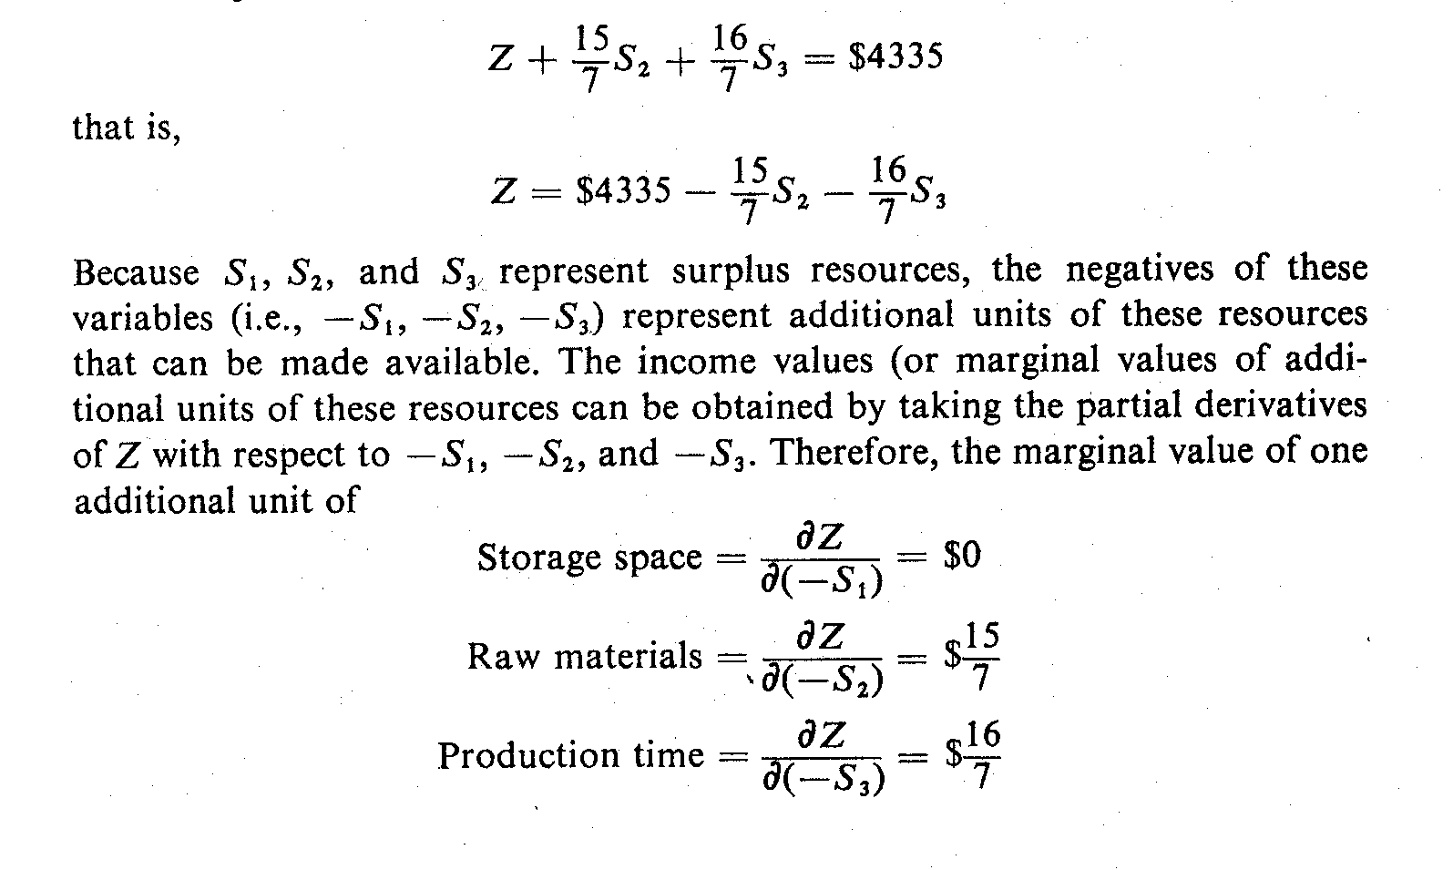
Marginal Values of Additional Resources
The critical questions are:
  What is the income value (or marginal value) of each additional unit of each type of resources?
  What is the maximum cost ( or marginal cost) that they should be willing to pay for each additional unit of resources?
Answers to these questions can be obtained from the objective function in the last tableau of the simplex solution:
Notes:
At this point we want to know whether additional resource will increase the value of objective function or how much will it increase if it does at all. This type of analysis is known as sensitivity analysis. To analyze the sensitivity we need to focus on the objective function obtained from optimal solution – which is shown in this slide.

Slide 22
Marginal Values of Additional Resources
Because S₁, S₂ and S₃ represent surplus resources, the negatives of these variables (i.e., -S₁, -S₂, -S₃) represent additional units of these resources that can be made available.
The income values (or marginal values of additional units of these resources can be obtained by taking the partial derivatives of Z with respect to -S₁, -S₂ and -S₃.
Therefore, the marginal value of one additional unit of:
Notes:
From this slide we can see that there is no impact of one additional storage space on objective function. But there are positive impacts of raw material and production time on objective function. Actually production time has slightly higher impact ($16/7 per additional hour) on objective function that additional raw material ($15/7 per additional raw material).

Slide 23
Marginal Values of Additional Resources
Thus, the marginal values of additional units of resources can be obtained directly from the coefficients of the objective function in the last tableau of a simplex solution.
The N. Dustrious Company should be willing to pay up to $15/7 for an additional unit of raw materials and $16/7 for an additional unit of production time.
If the actual cost of an additional unit (i.e., marginal cost) of these resources are smaller than the marginal value, the company should be able to increase its income by increasing production.
The marginal values above are valid, however, only as long as there is surplus storage space available.
Notes:
The N. Dustrious Company should be willing to pay up to $15/7 for an additional unit of raw materials and $16/7 for an additional unit of production time.
If the actual cost of an additional unit (i.e., marginal cost) of these resources are smaller than the marginal value, the company should be able to increase its income by increasing production.

Slide 24
Sensitivity Analysis
Sensitivity analysis helps to test the sensitivity of the optimum solution with respect to changes of the coefficients in the objective function, coefficients in the constraints inequalities, or the constant terms in the constraints.
For Example in the case study discussed:
  The actual selling prices (or market values) of the two products may vary from time to time. Over what ranges can these prices change without affecting the optimality of the present solution?
  Will the present solution remain the optimum solution if the amount of raw materials, production time, or storage space is suddenly changed because of shortages, machine failures, or other events?
  The amount of each type of resources needed to produce one unit of each type of product can be either increased or decreased slightly. Will such changes affect the optimal solution ?
Notes:
Sensitivity analysis helps to test the sensitivity of the optimum solution with respect to changes of the coefficients in the objective function, coefficients in the constraints inequalities, or the constant terms in the constraints.

Slide 25
Complications in Simplex Method
An objective function to be minimized instead of maximized.
Greater-than-or-equal-to constraints.
Equalities instead of inequalities for constraints.
Decision variables unrestricted in signs.
Zero constants on the right-hand side of one or more constraints.
Some or all decision variables must be integers.
Non-positive constants on the right-hand side of the constraints.
More than one optimal solution, that is, multiple solutions such that there is no unique optimal solution.
The constraints are such that no feasible solution exists.
The constraints are such that one or more of the variables can increase without limit and never violate a constraint (i.e., the solution is unbounded).
Some or all of the coefficients and right-hand-side terms are given by a probability distribution rather than a single value.
Notes:
These are the complications in Simplex Method. To avoid these complications we can use MS Excel solver to solve LP problems. In the next class we will solve LP problem using Excel Solver.

